Slide 1
Global Historical Precipitation Time Series Analysis
Yuhan Meng, Xueqian Zhang,
Chenghui Li, Jitian Zhao

Slide 2
Outline：
Data Description
Data Preprocessing
CHTC data processing
Result

Slide 3
Data Description

Slide 4
Data description
URL: https://www.ncei.noaa.gov/data/global-historical-climatology-network-daily/
Data Context: The Global Historical Climatology Network–daily dataset is a set of daily climate summaries from thousands of weather stations around the world.
Data Format: Each file represents climate data collected over years at one station. There are a lot of missing values in our data. Some station might lack precipitation data and use snowfall instead, some only have data in a short period of time.

Slide 5
Data Preprocessing

Slide 6
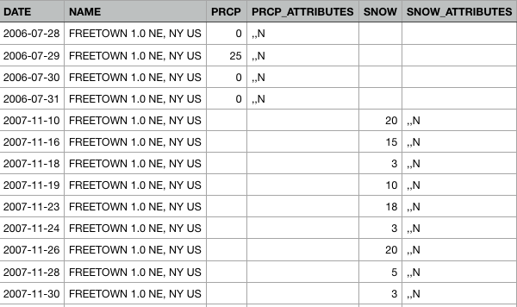
Data processing

Slide 7
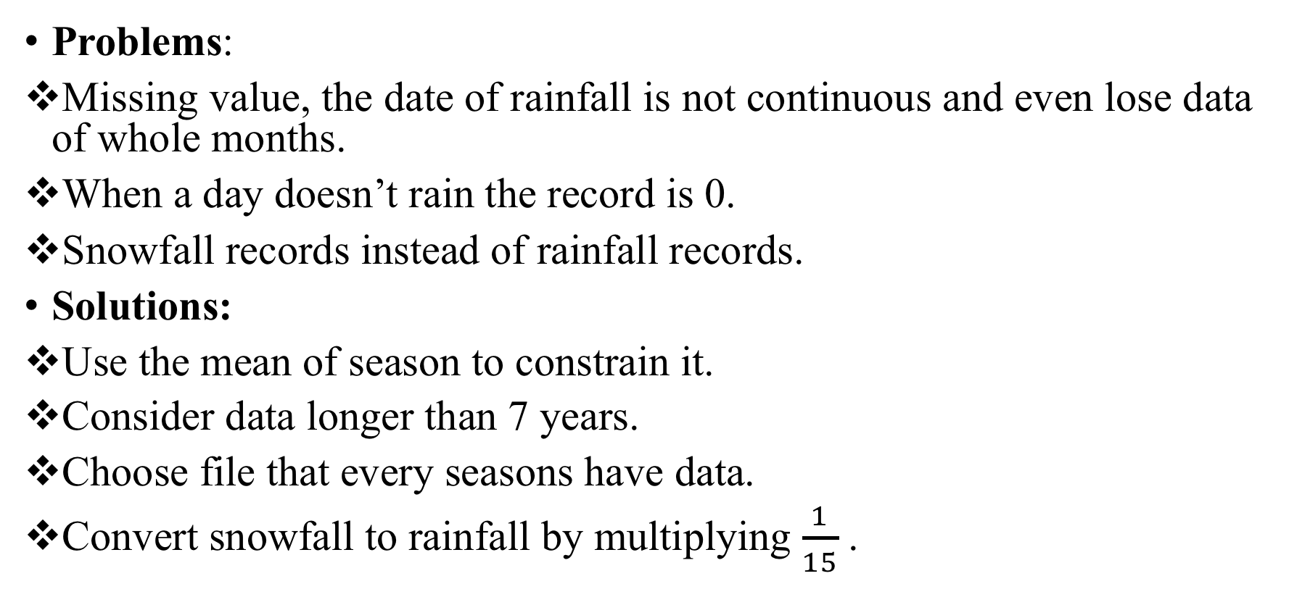
Data processing
Problems:
Missing value, the date of rainfall is not continuous and even lose data of whole months.
When a day doesn’t rain the record is 0.
Snowfall records instead of rainfall records.
Solutions:
Use the mean of season to constrain it.
Consider data longer than 7 years.
Choose file that every seasons have data.
Convert snowfall to rainfall by multiplying $\frac{1}{15}$ .

Slide 8
CHTC data processing

Slide 9
CHTC data processing
Location Selection
Data spliting and parallel processing
Get best 50 models
Write a match.sh to choose only stations from CA, CH, UK and US these four large countries.
Fit ARIMA model for each time series and compute AIC.
Merge the output AIC together and sort them from smallest to largest and extract only the first 50.

Slide 10
CHTC data processing
Location Selection
Data spliting and parallel processing
Get best 50 models
Problems in the processing!

